Slide 1
Prokaryotic and Eukaryotic Cells

Slide 2
Comparing Prokaryotic Cells with Eukaryotic Cells
Cells in our world come in two basic types, prokaryotic and eukaryotic.
"Karyose" comes from a Greek word which means "kernel," as in a kernel of grain. In biology, we use this word root to refer to the nucleus of a cell.
"Pro" means "before," and "eu" means "true," or "good." So "Prokaryotic" means "before a nucleus," and "eukaryotic" means "possessing a true nucleus."
Prokaryote – no nucleus
Eukaryote - has a nucleus

Slide 3
Prokaryotic Cells
Believed to be the first cells to evolve.
No “true” nucleus
Lack a membrane bound nucleus
No membrane bound organelles.
Ribosomes are only organelle.**

Slide 4
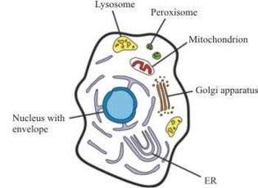
Eucaryotic Cells
Functional relationships of cellular structures

Slide 5
Eucaryotic Cells
Distinct Nucleus.
organelles except the ribosomes enclosed with a membrane.
Can be plant, animal or fungi.

Slide 6
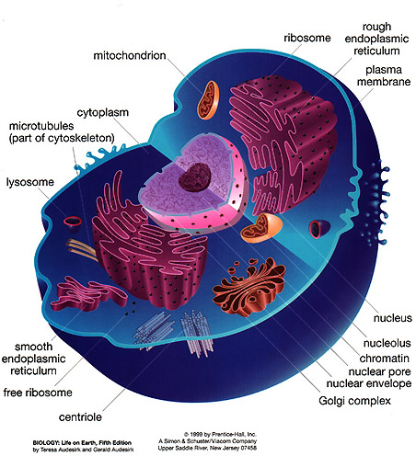
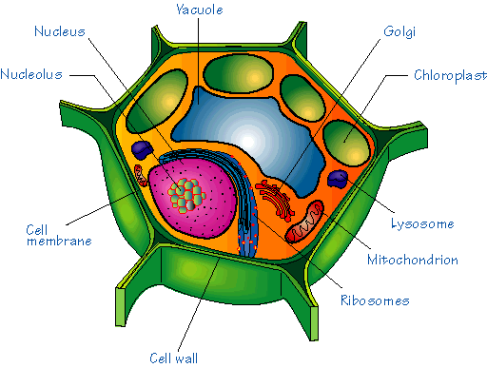
Eucaryotic Cells
There are two types of Eucaryotic cells.
animal cell.
plant cell

Slide 7
Animal cell Organelles
contain centrioles
do not contain a cell wall or chloroplasts

Slide 8
Plant Cell organelles
Surrounded by a Cell wall.
made of cellulose to stiffen and support the cell.
Contain plastids.
chloroplasts convert sunlight and carbon dioxide into glucose and release oxygen.
Large central vacuole.
used to store various molecules and support the cell.

Slide 9
Animal and Plant Cell Organelles
plasma membrane.
on the outside of the animal cell.
just inside the cell wall of a plant cell.

Slide 10
Animal Cell plasma membrane
two layers of phospholipids.
flexible
regulate passage of molecules.
five types of proteins imbedded.
pumps, pores, enzymes, receptors, cell recognition.
carbohydrate chains on the outer surface
Glycolipid, Glycoprotein for cellular ID
cholesterol
stiffens and strengthens membrane

Slide 11
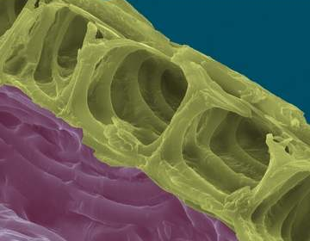
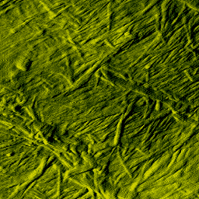
Cell Wall (only in plants and some fungi)
Made of interwoven cellulose fibers.
Cellulose is a polymer of glucose.
Lignin glues fibers together.
Provides a rigid permeable covering for plant cells.

Slide 12
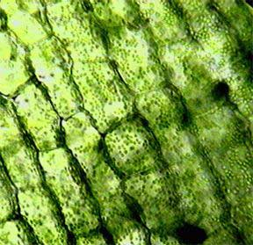
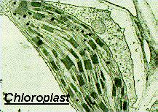
Chloroplasts
Only found in plant cells
Converts CO2 into carbohydrates using light energy.
Photosynthesis
6CO₂ + 6H₂O → C₆H₁₂O₆ + 6O₂
Carbon Dioxide + Water → Glucose + Oxygen

Slide 13
Mitochondria
Both animal and plant cells have mitochondria.
Energy converters

Slide 14
Mitochondria
Double layered.
inner cristae.
matrix. [space]
Contain DNA
inherited from the mother.
Performs cellular respiration
Converts glucose and oxygen into ATP energy, water and carbon dioxide.
C6H12O6 + 6O2 → 6CO2 + 6H2O

Slide 15
Chloroplasts and Mitochondria
glucose and oxygen
carbon dioxide, water
Chloroplast
Photosynthesis.
uses the energy of the sun to convert carbon dioxide and water into glucose.
Oxygen is a waste product.
Mitochondria
Cellular respiration
uses the glucose and oxygen to make usable ATP energy for the Cell.
Water and carbon dioxide are waste products
Carbon, oxygen and hydrogen are recycled between the two organelles

Slide 16
Cytoskeleton
Microtubules and microfilaments.
Maintain cell shape**
Control the movement of organelles within the cytoplasm.

Slide 18
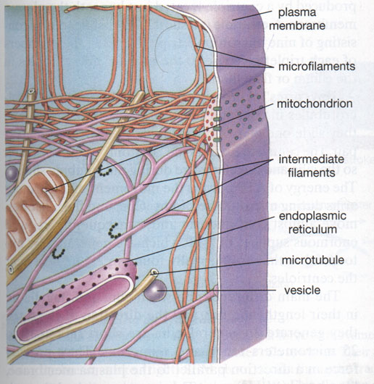

Slide 19
Cilia and Flagella
Both are extensions of the cytoplasm
contain a 9 plus 2 pattern of microtubules.
move in an undulating oar-like motion.
Cilia are shorter.
the upper micro photo shows cilia used to sweep debris and mucous up the trachea.
Flagella are longer
shown on the spermatozoan.

Slide 20
Endoplasmic Reticulum
a system of membrane channels that connect the nucleus with the plasma membrane.

Slide 21
Endoplasmic Reticulum

Slide 22
Endoplasmic Reticulum
Rough ER [RER]
covered with ribosomes.
assemble and transport proteins.
Smooth ER [SER]
no attached ribosomes.
transport proteins to the Golgi apparatus.
produce steroid hormones.
testosterone in the testis.
estrogen and progesterone in the ovary
detoxify drugs.
cells of the liver

Slide 23
Ribosomes
Attached to the RER
assembly point for proteins that will be secreted by the cell.
polyribosome / polysome.
Groups of ribosomes which synthesize proteins that will be used within the cell.
peptide/protein strands can be seen forming on this polysome

Slide 24
Golgi [Body / apparatus]
Pancake-like stacks of membranes.
receive proteins from the ribosomes.
sort, modify, repackage these proteins into vesicles.
vesicles can be used to secrete proteins from the cell (exocytosis).
vesicles containing digestive enzymes can remain with in the cell and form lysosomes.
lysosomes will fuse with incoming food vacuoles and the enzymes will cut up the food into subunits
Vesicles are small and contain protein, vacuoles are larger.

Slide 25
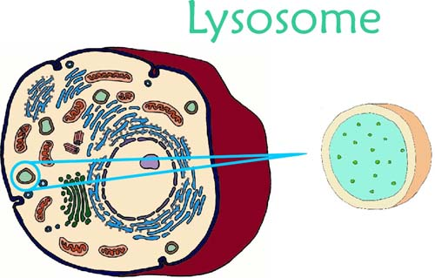
Produced by the Golgi body
Contain hydrolytic enzymes for digestion of food particles.
Digest old and worn out organelles.
Digest worn out cells. [Autolysis]

Slide 26
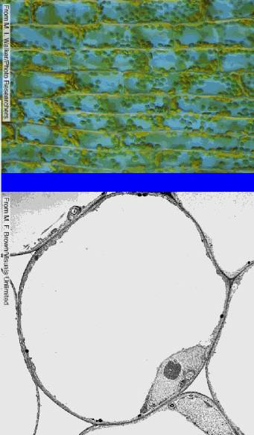
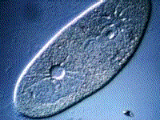
Vacuole
Large membrane enclosed sac.
Used for storage of many substances.
Larger in plants.
Help support the plant.
Protists use these for expelling water.

Slide 27
Nucleus/Nucleolus
Nucleus
Stores genetic information as DNA and proteins as chromatin
Nuclear envelope
a double membrane with pores that allow protein synthesis information to be carried to the ribosomes
Nucleolus
produces ribosomal RNA that are assembled into ribosomes.

Slide 28
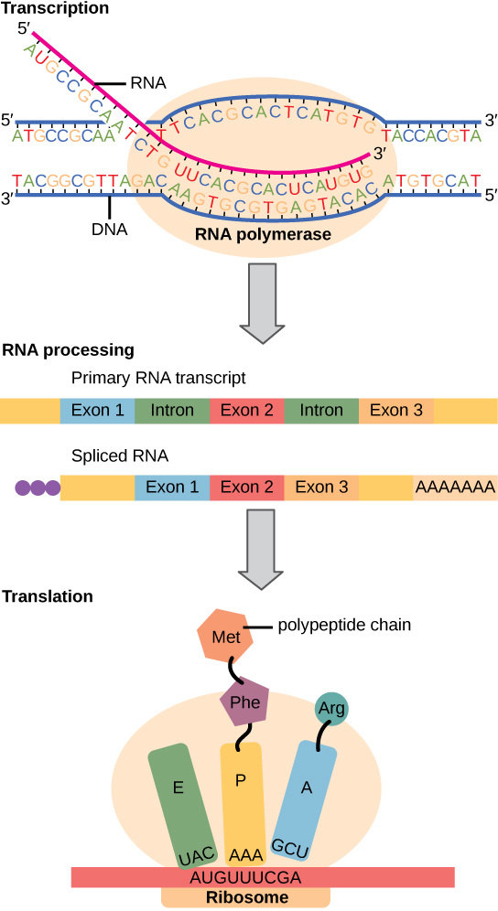

Slide 29
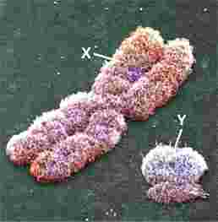
Chromatin
Grainy material made of DNA and protein.
Chromosomes
Coiled DNA and Protein.
Enables DNA to separate during Cell Division.

